Slide 1
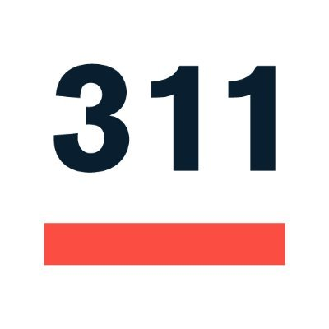
Analyzing Requests
Team 1

Slide 2

Analyzing 311 Requests - Team 1
Sponsor: At-Large City Councilor Julia Mejia
Members: Ivan Nikitovic
Haoxuan Sun
Stephen Wong
Motivation: We wanted to research whether there is a pattern between areas that report 311 calls and have them responded to, and the demographics of those regions.
Goal: Analyze patterns in 311 requests, geography, and various demographics in order to see who feels empowered to make the requests and if they have been responded to equitably.
Background: Using 311 and Social Vulnerability Index and other datasets, we want to study the relationships between vulnerable populations and their requests.
Notes:
Motivation: We want to find if there is a pattern between areas that report 311 calls and have them responded to, and the demographics of those regions.
Goal: Analyze patterns in 311 requests, geography, and various demographics in order to see who feels empowered to make the requests and if they have been responded to equitably.
Background: Using 311 and Social Vulnerability Index datasets, we want to study the relationships between vulnerable populations and their requests.

Slide 3

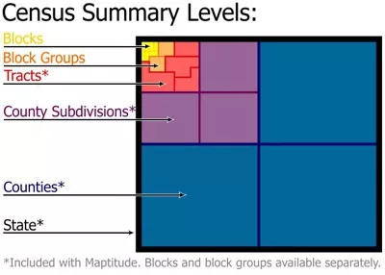
Data
Social Vulnerability Index - Climate Ready Boston Social Vulnerability dataset
MA Voter Files - The dataset containing voter information for Massachusetts (from 2002)
311 Requests (Harvard Dataverse) - The dataset with 311 calls (from 2010)
Census Tracts 2010 - Census tracts are small, relatively permanent statistical subdivisions of a county or equivalent entity
Building and Property Violations - issued by inspectors from the Building and Structures Division of the Inspectional Services Department

Slide 4
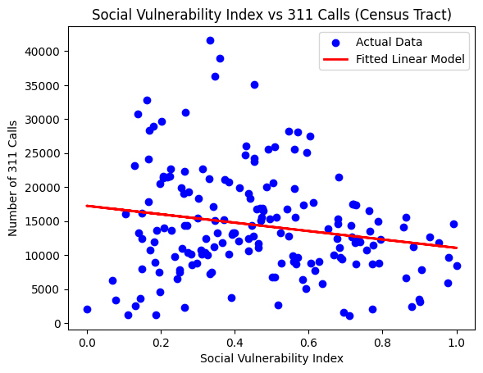
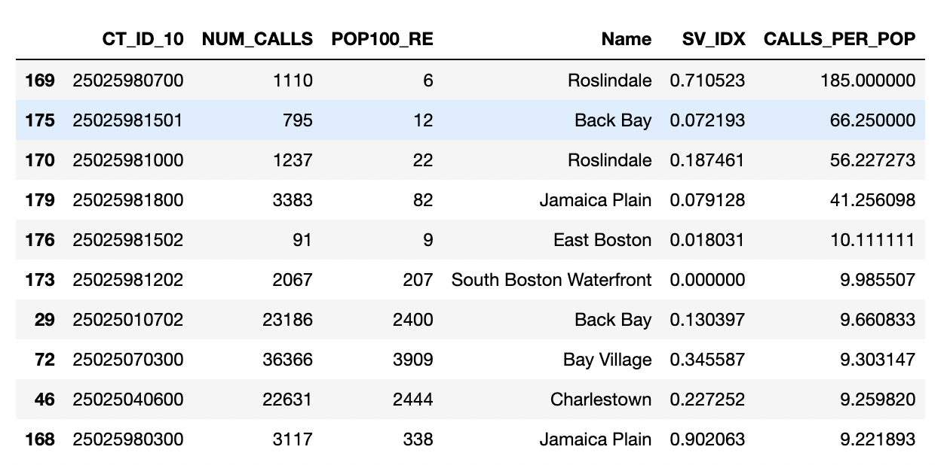
1. Analyze which Census Tract submitted the most service requests?
Weak negative relationship found between number of 311 calls and SV Index. The more empowered a community is, the more likely they are to call 311.

Slide 5
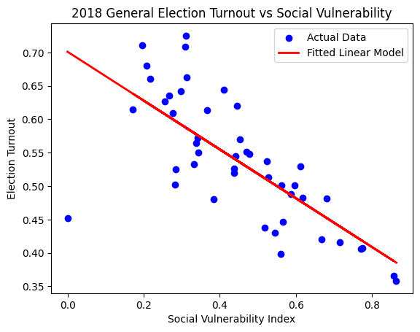
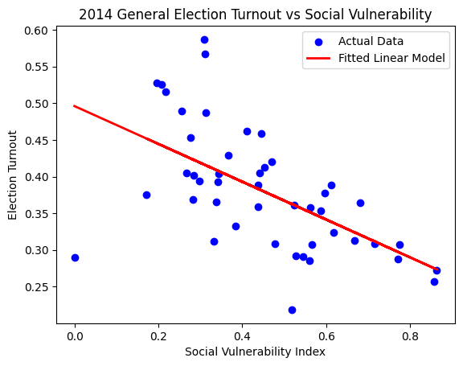
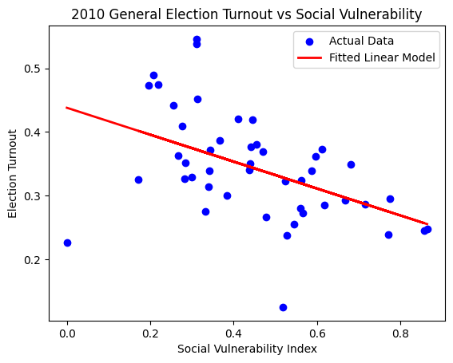
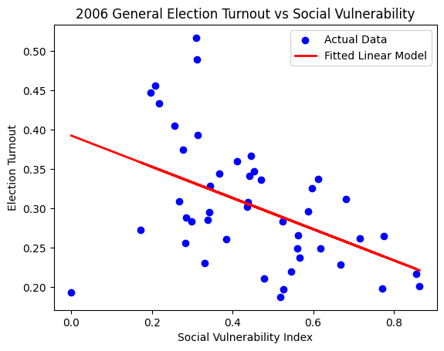
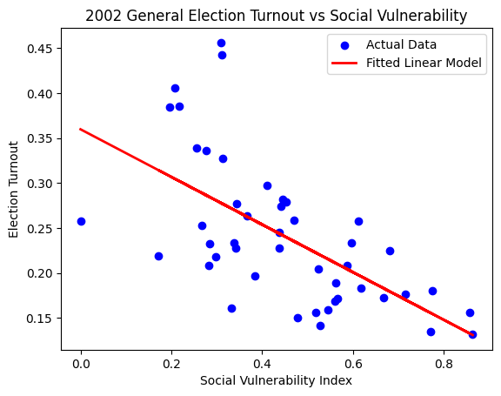
2. What is the relationship between voting status (i.e. registered voters and and civic empowerment? What is the average voting turnout for each district over past 20 years?
Strong negative relationship found between between voting turnout and SV Index. The more vulnerable a community is, the less likely they are to vote.

Slide 6
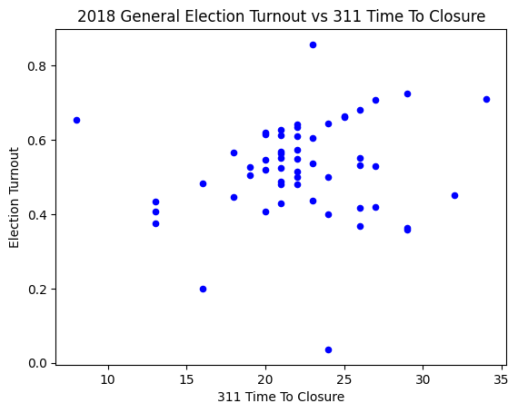
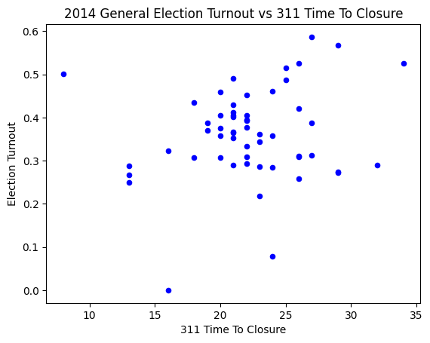
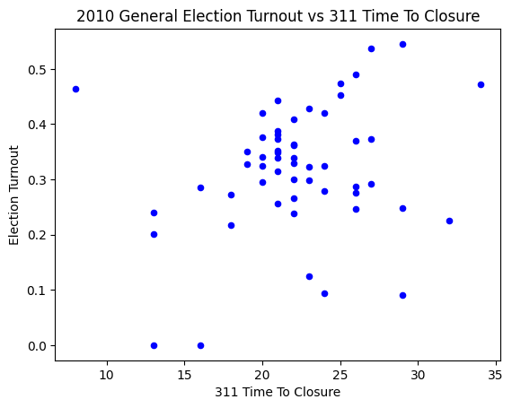
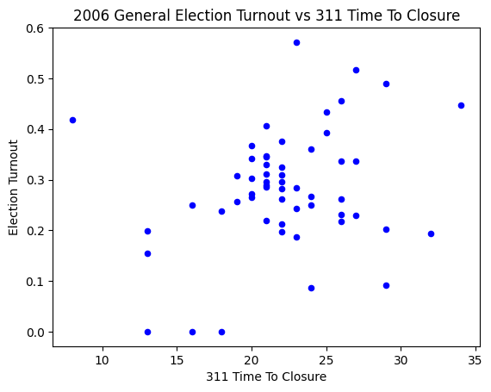
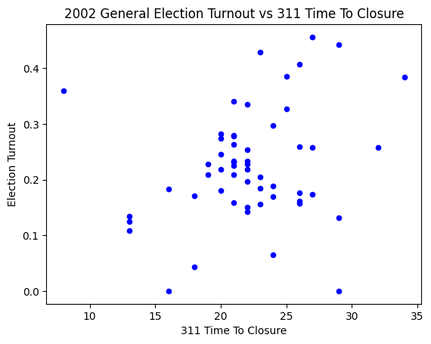
3. What is the relationship between voting status (i.e. registered voters and and city responsiveness in terms of closing 311 requests? What is the average voting turnout for each district over past 20 years?
No relationship currently found between voting turnout and city responsiveness to 311 requests.

Slide 7
Idea: Analyzing the relationship between property violations and 311 requests.
Data: Boston government dataset (https://data.boston.gov/dataset/building-and-property-violations1)
Aim: Allocate specific resources to the neighborhoods with high rates of building violations to mitigate public safety risks and improve quality of life.
Reason
Aid in developing effective prevention and addressing strategies.
Inform policy decisions and improve Bostonians' lives.
Extension

Slide 8
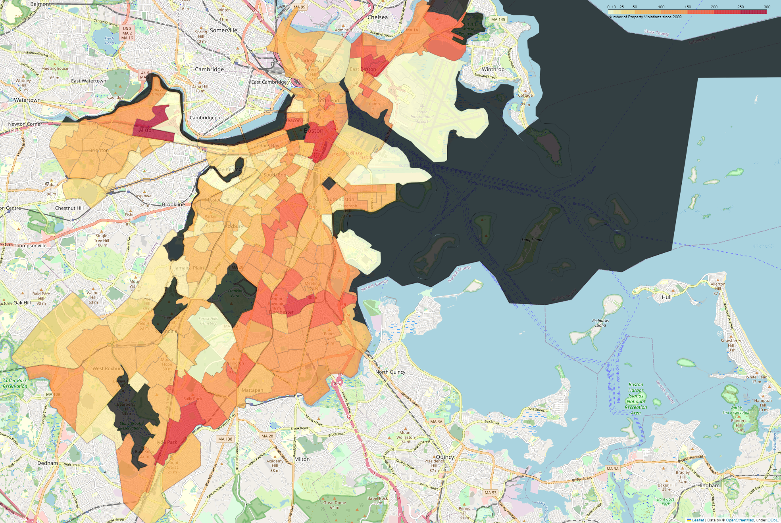
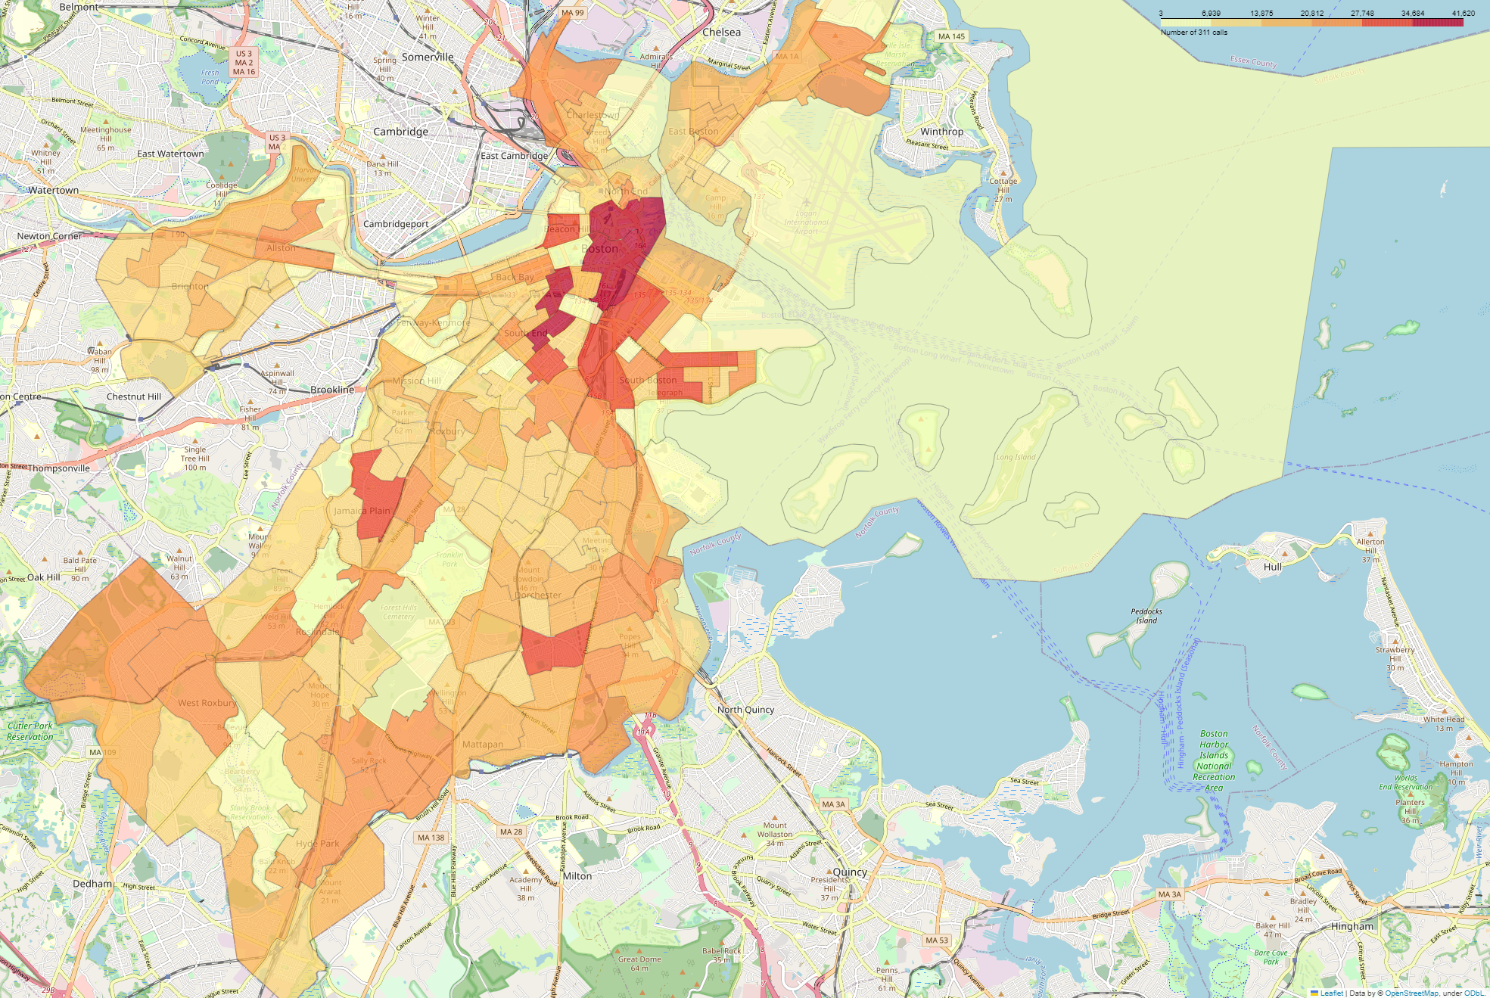
Pattern between the number of property violations and 311 calls.
Number of Property Violations since 2009
Number of 311 Calls since 2010
Extension

Slide 9
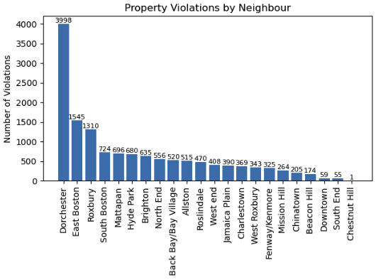
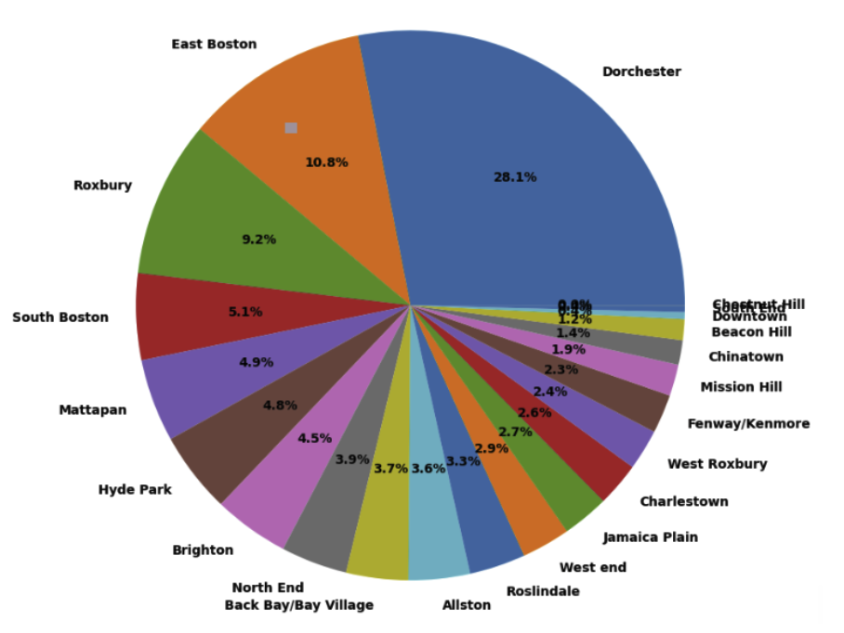
Areas have the most property violations: Dorchester
Property Violations by City (Count)
Property Violations by City (Percentage)
Extension

Slide 10
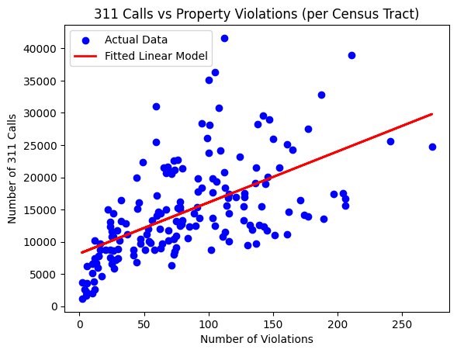
Extension: Is there a correlation between the number of 311 calls and the number of property violations per Census Tract?
Strong positive relationship found between the number of 311 calls and number of property violations.

Slide 11

Challenges
Data not being entirely compatible (GEOID), missing data, etc.
Wrong/contradictory data in property violation dataset
Confusion of tasks
Teammate dropped class mid-semester

Slide 12
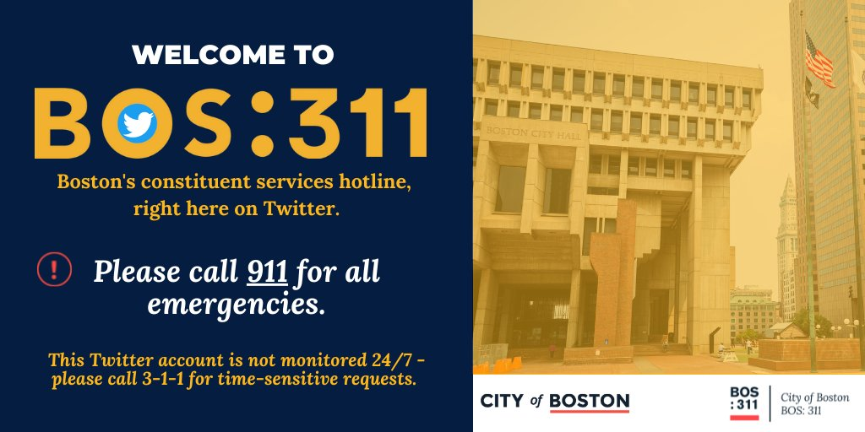
Thank you!

Slide 13
References
O'Brien. “311 Requests Database.” Harvard Dataverse, Harvard, 7 Oct. 2022, https://dataverse.harvard.edu/dataset.xhtml?persistentId=doi:10.7910/DVN/CVKM87.
“CLIMATE READY BOSTON SOCIAL VULNERABILITY.” Translated by Atyia Martin, Analyze Boston, Boston Government, 2015, https://data.boston.gov/dataset/climate-ready-boston-social-vulnerability.
Boston Maps Analytics Team. “CENSUS 2010 TRACTS.” Analyze Boston, Boston Maps, 4 Apr. 2019, https://data.boston.gov/dataset/census-2010-tracts.
“BUILDING AND PROPERTY VIOLATIONS.” Edited by Inspectional Services Department, Analyze Boston, Department of Innovation and Technology, 2023, https://data.boston.gov/dataset/building-and-property-violations1.
Voong, Michelle, editor. “Voter File MA.” Boston Voting File, 2020, https://drive.google.com/drive/folders/1DyCevtTWTMMNrZXsCycLGiSA_uc6lq8r.

